Slide 1
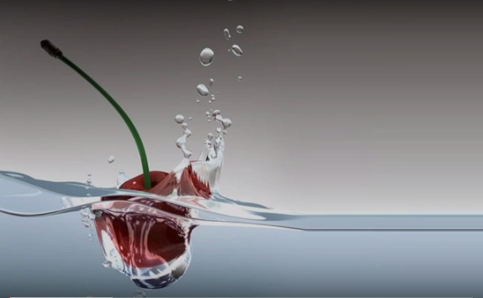

DEFENSE MECHANISMS OF THE GINGIVA
GINGIVAL CREVICULAR FLUID
LEUKOCYTES
SALIVA
RUNGTA COLLEGE OF DENTAL SCIENCES AND RESEARCH,BHILAI

Slide 2
SPECIFIC LEARNING OBJECTIVES
CORE AREAS | DOMAIN | CATEGORY
INTRODUCTION | Affective | Desire to know
DEFINITION | Cognitive | Must to know
HISTORY | Cognitive | Must to know
MECHANISM OF GCF PRODUCTION | Cognitive | Must to know
MECHANISM OF GCF COLLETION | Cognitive | Must to know
METHODS OF ESTIMATING GCF | Cognitive | Must to know
COMPOSITION OF GCF | Cognitive | Must to know
CLINICAL SIGNIFICANCE OF GCF | Cognitive | Must to know
SALIVA | Cognitive | Must to know

Slide 3
CONTENT
PART I
INTRODUCTION
DEFINITION
HISTORY
MECHANISM OF GCF PRODUCTION
MECHANISM OF GCF COLLETION
PART II
METHODS OF ESTIMATING GCF
COMPOSITION OF GCF
CLINICAL SIGNIFICANCE OF GCF
SALIVA

Slide 4
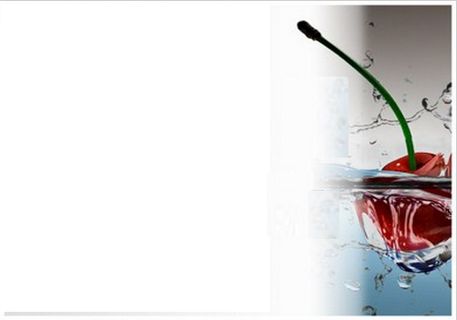
INTRODUCTION

Slide 5
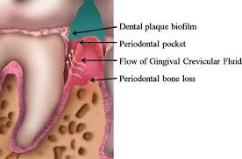
The gingival sulcus is an area that provides a biologic seal , but also the area where the plaque bacteria challenge the host.
The host however, has exquisite defense mechanisms that involve:
- Gingival Crevicular Fluid
- Saliva
- Leukocytes

Slide 6
DEFINITION

Slide 7
Gingival Crevicular Fluid (GCF)
“Tissue fluid that seeps through the crevicular and junctional epithelium. It is increased in the presence of inflammation”.
Glossary of Periodontal Terms – 4th edition 2001

Slide 8
HISTORY

Slide 9
Early 1950s......Waerhaug focused on the anatomy of the sulcus
Late 1950s and early 1960s......Brill et al. ......physiology of GCF formation and its composition.

Slide 10
Mid 1960s.....Loe et al 1965 .......the use of GCF as an indicator of periodontal diseases.
Cimasoni (1974) published the first edition of the monograph The Crevicular Fluid.

Slide 11
MECHANISM OF GCF PRODUCTION

Slide 12
The exact nature of the fluid, its origins and composition, has been the subject of controversy.
EXUDATE
TRANSUDATE

Slide 13
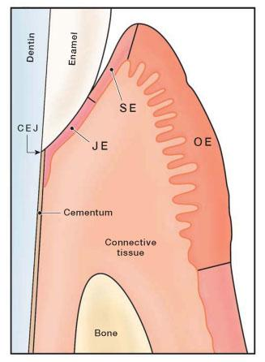
Anatomy of the Gingival Sulcus

Slide 14
Is GCF an inflammatory exudate?
The initial investigations of GCF attempted to relate its formation to the inflammatory changes in the connective tissues underlying the sulcular and junctional epithelia.
These changes were primarily an increased permeability of the blood vessels, which was induced by chemical or mechanical means.

Slide 15
Brill et al 1959 systemically administered fluorescein in dogs. GCF collected using filter paper strips.
Fluorescein appeared in the GCF collected.
Sample collected from other oral epithelia had not allowed the passage of the fluorochrome, hence, it was concluded that differences in permeability must exist between these oral epithelia and the epithelium lining the gingival pocket.

Slide 16
Subsequent experiments showed that the flow of gingival fluid increased markedly following stimulation of the gingivae by:
Tooth Brushing
By chewing
After intravenous injection of Histamine or
The development of inflammation.
This led to the conclusion that some irritation, whether chemical or mechanical, was necessary to induce the production of GCF and that it should therefore be considered as a PATHOLOGICAL PHENOMENON.

Slide 17
Is GCF a TRANSUDATE of interstitial fluid?
An alternative theory.........Alfano (1974) and Pashley (1976)........suggested that the initial fluid produced could simply represent interstitial fluid which appears in the crevice as a result of an osmotic gradient.
This initial, pre-inflammatory fluid was considered to be a transudate, and, on stimulation, this changed to become an inflammatory exudate.

Slide 18
At a clinically healthy gingival crevice
Bacterial plaque would result in the accumulation of high molecular weight molecules.
These would permeate the intercellular regions of the epithelium, but would then be limited by the basement membrane.
An osmotic gradient will be produce which would induce the flow of interstitial fluid from the connective tissue to the gingival sulcus.

Slide 19
Mathematical model of Pashley, illustrated within the gingival crevice.
Absence of inflammation: low vascular permeability and low permeability of the basement membrane results in low GCF flow and high % uptake by lymph vessels.
(b) Macromolecules of plaque result in an osmotic gradient, increased vascular permeability and basement membrane changes, resulting in increased passage of fluid into the tissues and increased GCF production.

Slide 20
METHOD OF GCF COLLECTION

Slide 21
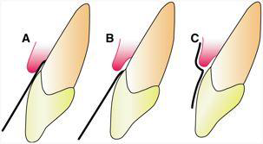
The methods of collection may be broadly divided into:
INTRACREVICULAR
EXTRACREVICULAR

Slide 22
The techniques can be divided into following basic strategies:
Gingival washing methods
Capillary tubing or micropipettes
Absorbent filter paper strips
Preweighed twisted threads

Slide 23
Gingival washing methods
In this technique the gingival crevice is perfused with an isotonic solution, such as Hanks’ balanced salt solution, usually of fixed volume.
The fluid collected then represents a dilution of crevicular fluid and contains both cells and soluble constituents such as plasma proteins.

Slide 24
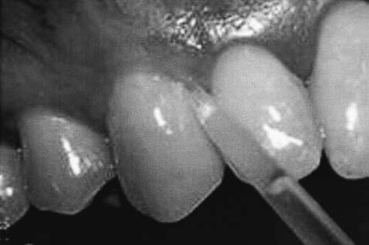
The simplest method.....Skapski and Lehner 1976
Involved the instillation and re-aspiration of 10ml of Hanks’ balanced salt solution at the interdental papilla.
This process was repeated 12 times to allow thorough mixing of the transport solution and GCF.
applied either to individual interdental units or to multiple units
Notes:
The major disadvantage of this technique is that all fluid may not be recovered during the aspiration and re-aspiration procedure. Thus accurate quantification of GCF volume or composition is not possible as the precise dilution factor cannot be determined.

Slide 25
A more complicated method......Oppenheim FG 1970
Involved the construction of a customized acrylic stent which isolate the gingival tissues from the rest of the mouth.
The tissues were then irrigated for 15min, with a saline solution, using a peristaltic pump, and the diluted GCF was removed.
Valuable for harvesting cells from the gingival crevice region.
Notes:
It has also usually only been applied to the maxillary arch, presumably because of the difficulties of producing a technically satisfactory appliance for the mandibular arch.

Slide 26
Capillary tubing or micropipettes
Following the isolation and drying of a site, capillary tubes of known internal diameter are inserted into the entrance of the gingival crevice.
GCF from the crevice migrates into the tube by capillary action and because the internal diameter is known the volume of fluid collected can be accurately determined, by measuring the distance which the GCF has migrated.
This technique appears to be ideal as it provides an undiluted sample of ‘native’ GCF whose volume can be accurately assessed.
Notes:
This technique appears to be ideal as it provides an undiluted sample of ‘native’ GCF whose volume can be accurately assessed.

Slide 27
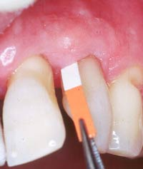
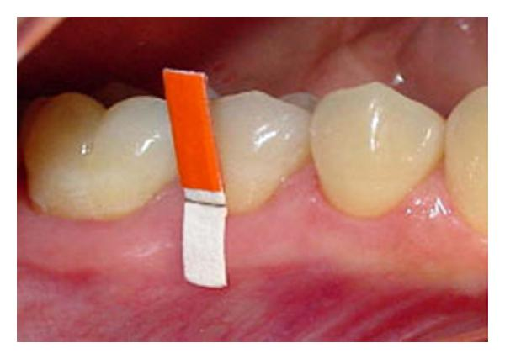
Absorbent filter paper strips
The advantages of the technique are that it is quick and easy to use, can be applied to individual sites and, possibly, is the least traumatic when correctly used.

Slide 28
Preweighed twisted threads
Weinstein et al ( 1967 ) inserted preweighed twisted threads into the gingival crevice around the tooth, and determined the amount of fluid collected by weighing the sample thread.

Slide 29
SUMMARY
The presence of GCF or sulcular fluid has been known since
19th century and its compostion and possible role in oral
defense mechanisms were elucidated by the pioneering work of
Waerhaug and Brill and Krasse.
• In strictly normal gingiva little or no fluid can be collected.
• GCF can be collected intrasulcular method and extrasulcular
Method.
Saliva secretions are protective in nature because they maintain
the oral tissues in physiologic state.
• It has antibacterial, lubricating, cleansing, and buffering action.
It also helps in physical protection and tooth integrity.

Slide 30
REFERENCE
Newman MG, Takei HH, Klokkevold PR, Carranza FA. Carranza’s clinical periodontology, 10th ed. Saunders Elsevier; 2007.
Lindhe J, Lang NP and Karring T. Clinical Periodontology and Implant Dentistry. 6th ed. Oxford (UK): Blackwell Publishing Ltd.; 2015.
Newman MG, Takei HH, Klokkevold PR, Carranza FA. Carranza’s clinical periodontology, 13th ed. Saunders Elsevier; 2018.

Slide 31
THANK YOU

